Slide 1
Wise Money Management
Members:
Lateisha Brown
Khajae Burton
Trudy Williams
Charmaine Allen
Elesia Robinson

Slide 2
What is Budgeting?
Budgeting is the process of creating a plan to spend your money wisely. Creating this spending plan allows you to determine in advance whether you will have enough money to do something.

Slide 3
Benefits of Budgeting
Reveals waste
Controls spending
Grows savings
Accelerates financial goals
Reduce stress

Slide 4
What should be included in your budget?
Your income
Variable expenses
Fixed Expenses
Investments and Savings

Slide 5
Tips for managing your money
Track your expenses
Make a list of all recurring bills including credit card loan payments and utilities.
Compare your grand spending total with your income total.
Always verify
Do not overspend or underspend.
Create an emergency

Slide 6
Question and Answer

Slide 7
Question 1
What is Budgeting?

Slide 8
Answer
Budgeting is the process of creating a plan to spend your money wisely.

Slide 9
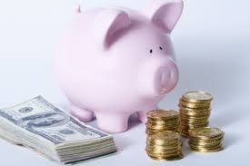
Question 2
State any 2 benefits of budgeting

Slide 10
Answers
Reveals waste
Controls spending
Grows savings
Accelerates financial goals
Reduce stress

